Slide 1





The
Porcupine Abyssal Plain
sustained observatory
Notes:
PAP specifically

Slide 2
Insights from PAP after 30 years of observation.
Richard Lampitt
NOC, Southampton.
OceanSITES conference April 2016, Southampton

Slide 3
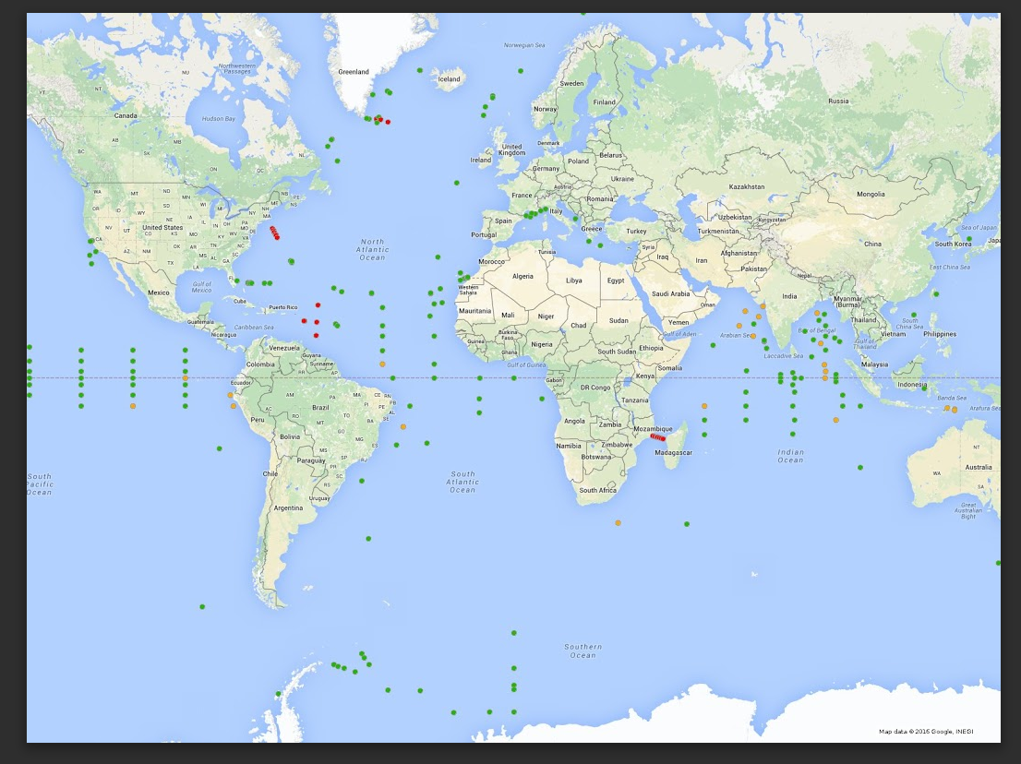
OceanSITES
The global network of Deep ocean Eulerian observatories
3
Notes:
3

Slide 4
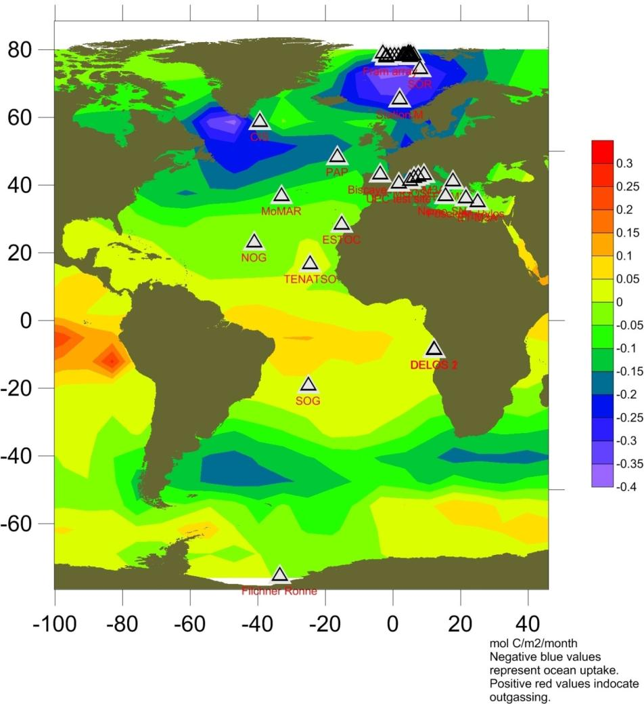
PAP is a component of
FixO³
With air-sea flux of CO2
(average 2000)
(From Takahashi et al 2009)
4
Courtesy Ute Schuster, UEA

Slide 5
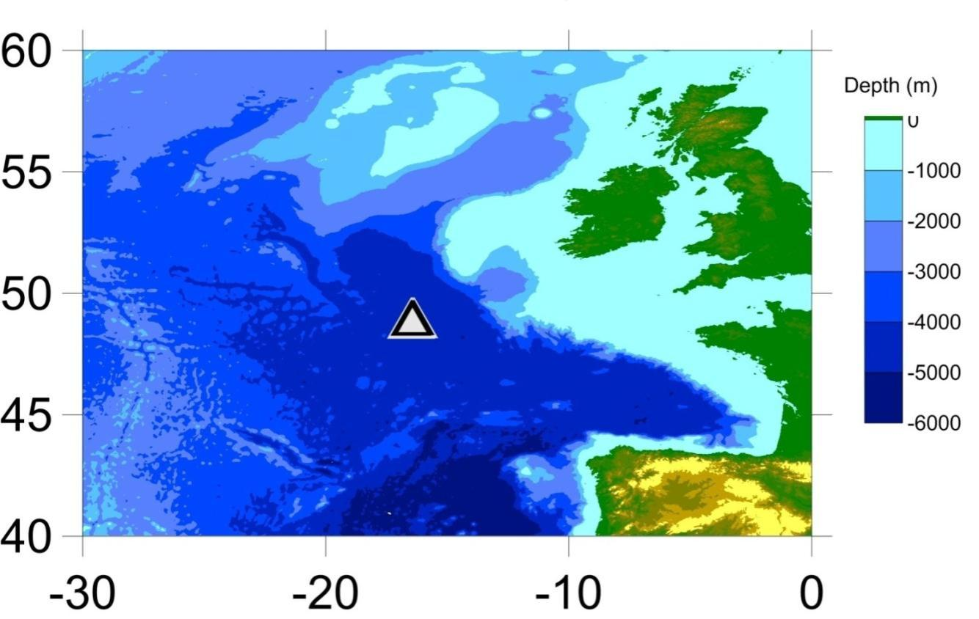
The PAP sustained observatory
49ºN, 16.5ºW; water depth ~ 4800 m

Slide 6
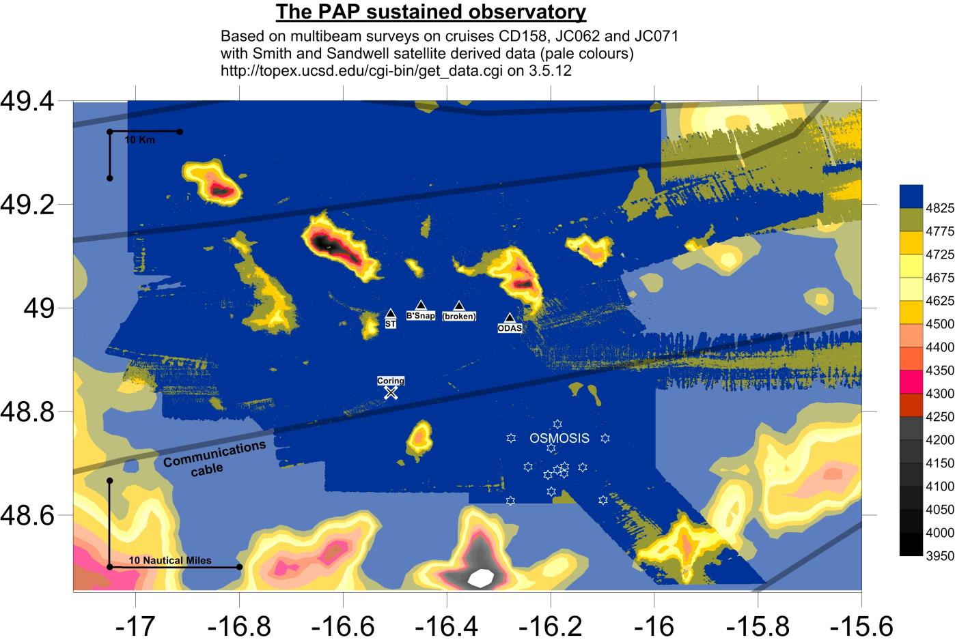

Slide 7
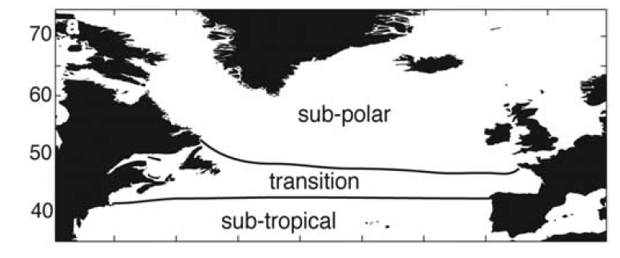
Mean condition
Text
Henson et al. (2009),

Slide 8
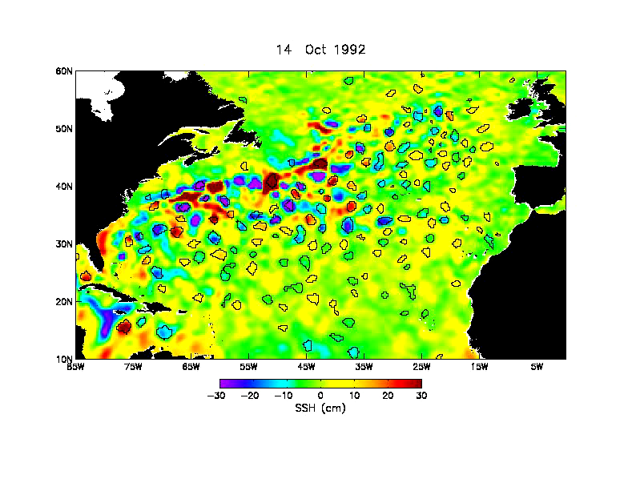
Courtesy Dudley Chelton

Slide 9
Observing systems
Satellite remote sensing
Gliders
Floats
Ships of Opportunity
Research cruises
Eulerian observatories
Computational models
All approaches have strengths and weaknesses

Slide 10
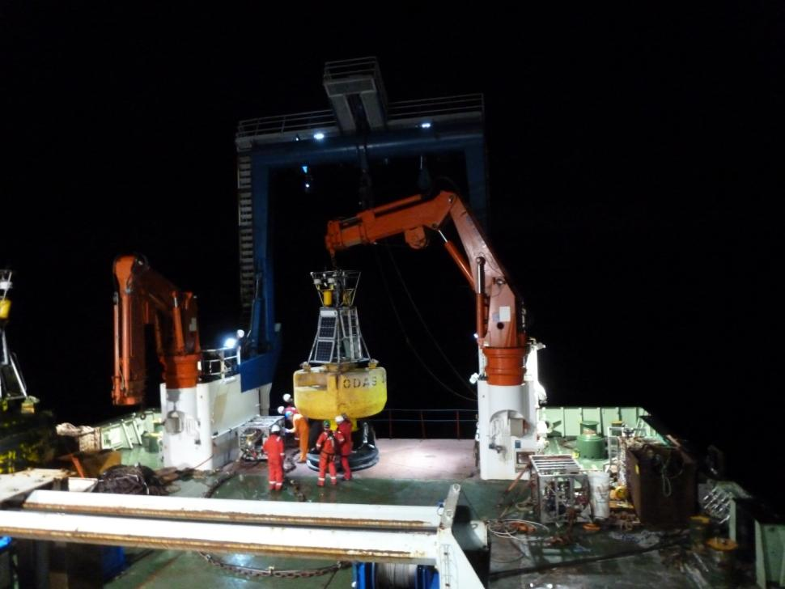
Preparation of ODAS met buoy for deployment at PAP

Slide 11
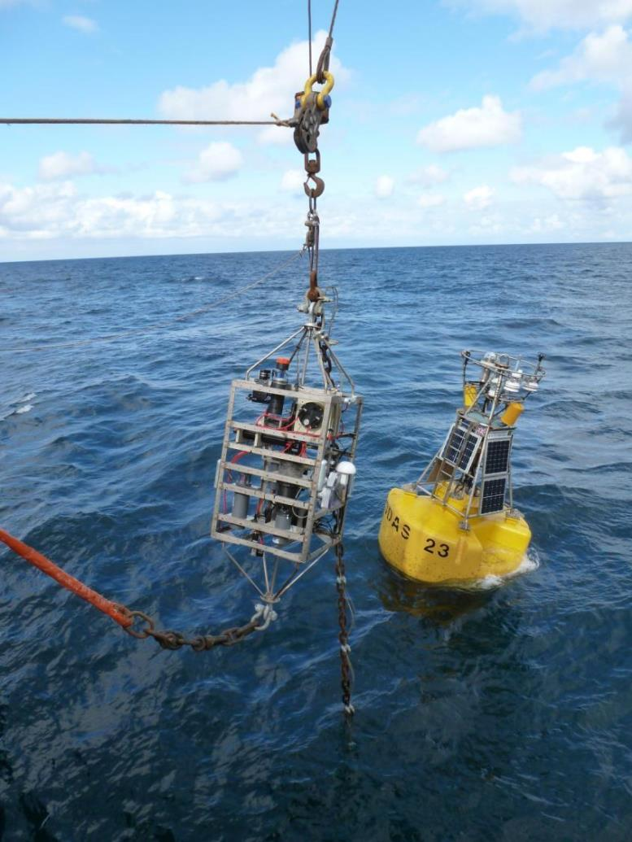
Deployment of observatory at PAP
Surface met buoy and frame with wide range of sensors to work at 30m depth.

Slide 12
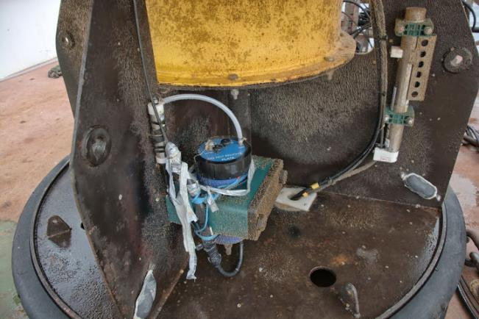
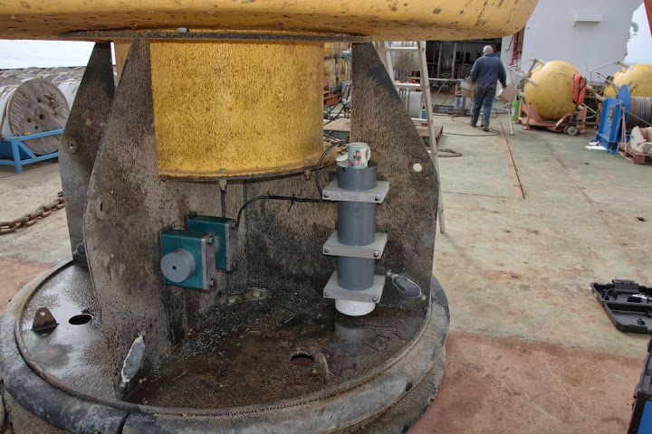
Sensors on the hull of the surface met buoy
CO₂
pH

Slide 13
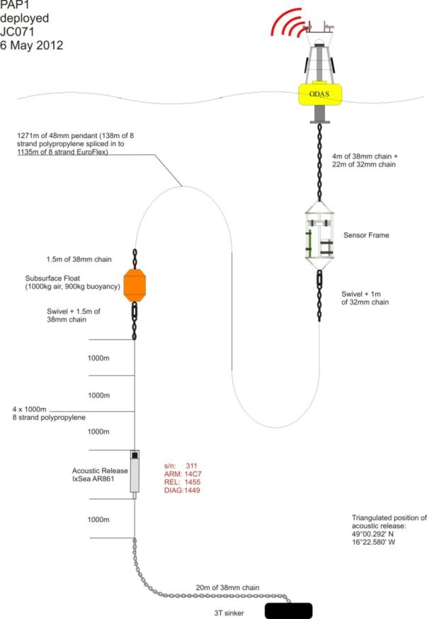
Multidisciplinary time-series. Vertical coverage: Atmosphere to Surface Ocean to Seafloor
Meteorology
Temperature
Salinity
Currents
Nutrients
Water sampling
Chl-a
Zooplankton sampling
CO₂
O₂
Particle flux
Benthic biology
Real-Time Telemetry
Notes:
Ocean observatories act as platforms for a wide range of multidisciplinary science for collecting high frequency data sets on climatically and ecologically relevant variables
Simultaneous measurements of many variables is essential to unravel linkage and forcing between parameters.
Seafloor and mesopelagic processes are often intimately linked (and in many cases largely driven) by biogeochemical and physical processes in the surface waters and euphotic zone. Ocean observation in the water column has historically developed separately from seafloor observation. In addition, there are many key science questions driven by societal needs that require a multi- and inter-disciplinary approach linking infrastructure from the surface through the water column to the seafloor and sub-seafloor.
Identify and extend the core parameters producing data on
global ocean time-series indicators e.g.
- pH
- assembled heat and freshwater content timeseries
- eddy energy timeseries
Products will be developed and provided to a variety of users e.g.
- air-sea flux data for model validation
- 15m currents for validation of drifter and satellite current products
- sea surface salinities for remote sensing validation
- wave data (surface moorings) for wave products/validation
- column integrated chlorophyll estimates (remote sensing/model
validation)
This figure shows a typical Moored observatory with a surface buoy. Along the mooring line, a wide range of physical, chemical and biological sensors are attached to measure variables at specific depths. Variables measured include T,S, nutrients, Chl-a, CO2, particle flux using sediment traps and currents. Many of these data are transmitted in real-time. This is achieved via the surface buoy which acts as a communications node with a satellite to transmit the data back to land. This mooring line is weighted to the seafloor and in some cases is connected to instrument packages on the seafloor for benthic research. This includes a similar package of sensors listed above for BBL measurements but also can include camera systems and landers for benthic experimentation.
The system can also be sent a command at any time via satellite to collect samples or send back temperature data. This interactivity will allow us to take samples quickly and at critical times, for example in response to any seismic or volcanic activity, long before any ship could get to the site

Slide 14
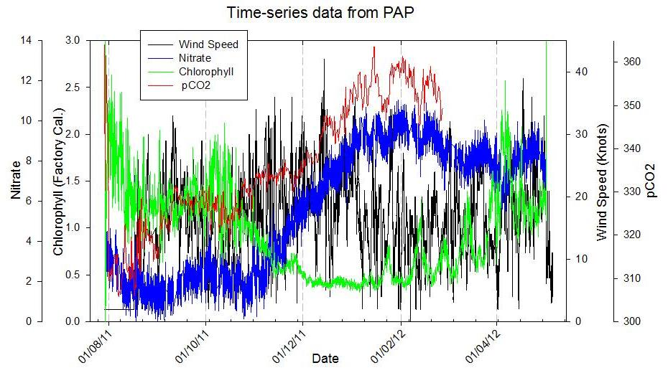
Real time biogeochemical and met data
Data from 30m
Aug. 2011 – May 2012
Nitrate & pCO₂ increases with convective mixing in the winter months as chlorophyll-fluorescence decreases.

Slide 15
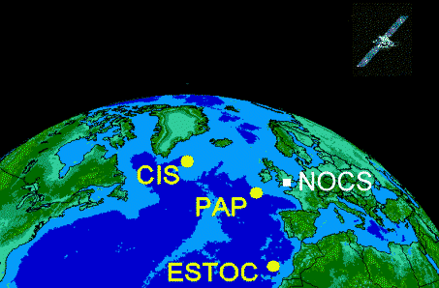

Slide 16
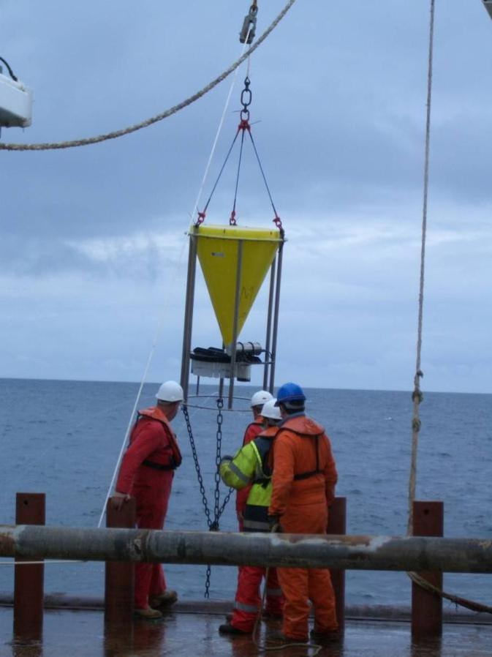
Deep water measurement of downward particle flux
3000m

Slide 17
Continuous
Plankton Recorder (CPR)
1948 - present
Notes:
Very few sufficiently long biological time series exist
to assess interannual- to decadal-scale variability in the
phytoplankton bloom. The exception is the Continuous
Plankton Recorder (CPR) program, which consists of a
qualitative index of phytoplankton color that indicates
relative changes in phytoplankton production [Reid et al.,
1998]. Consistent phytoplankton data are available from
1948 onward, and currently the survey consists of monthly

Slide 18
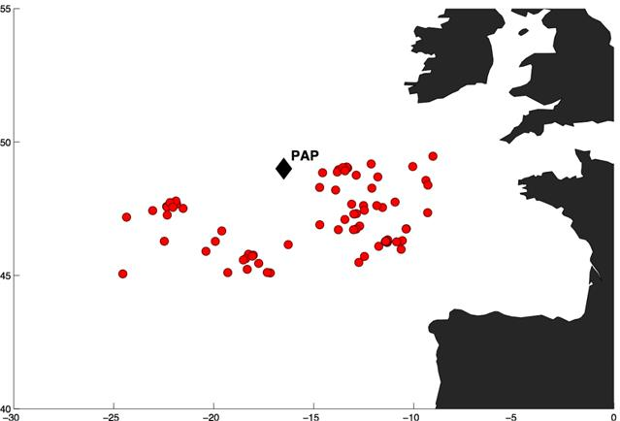


Slide 19
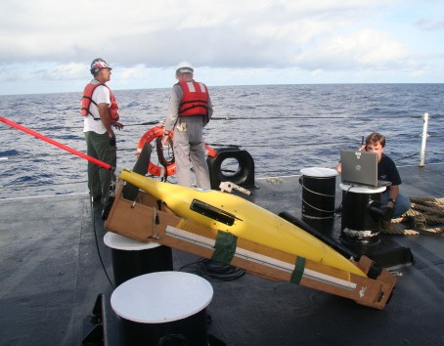
The Seaglider
Better spatial context

Slide 20
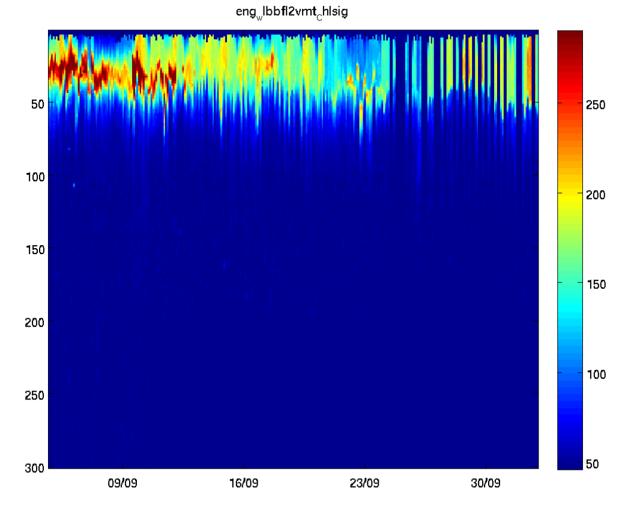
Chlorophyll at PAP in September 2012
Glider (OSMOSIS Mission 566)

Slide 21
Example 1
Long term trends

Slide 23
Lampitt et al 2010

Slide 24
Lampitt et al 2010

Slide 25
Are spring-time changes at PAP reflected in the time at which mixing decreases, productivity increases and deep ocean flux increases?
Lampitt et al 2010

Slide 26
Example 2
Air-Sea flux of CO₂

Slide 27
Anthropogenic CO₂ in the ocean (mol m⁻²)
Net uptake of anthropogenic CO₂ (1800-1994):
118 ± 19 Pg C yr⁻¹ = 48% of the emissions
Sabine et al 2004

Slide 28
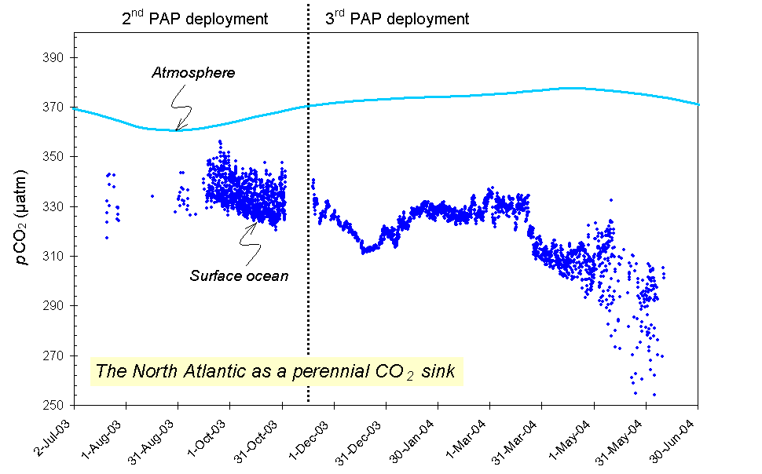
PAP: pCO₂ 2003-2004
(Körtzinger et al. 2007)
Notes:
Persistent undersaturation of surface waters throughout the year which gives rise to a perennial CO2 sink.
Regional trait: This continuous undersatuaration is characteristic of the entire subpolar North atlantic resulting from the general cooling of surface waters during their passage from low to high latitudes.
Over an annual cycle winter nitrate drives the biological pump of fixed carbon from the surface to depth.
We need to monitor how changes to the oceans such as increasing ocean acidification will affect the functioning of our marine ecosystem, productivity etc which may lead to less CO2 being absorbed into the oceans.
Reasons why this study is so important scientifically to study lon-term and at high resolution. A persistent feature of the North Atlantic is under-saturation of surface waters throughout the year which gives rise to a perennial CO2 sink. This makes this region of high global importance in the global carbon cycle. This continuous under-satuaration is characteristic of the entire subpolar North Atlantic resulting from the general cooling of surface waters during their passage from low to high latitudes. However, there is evidence for a trend of less CO2 being absorbed into the oceans (for the period 2003 to 2004) (Körtzinger et al. 2008). This shows that we need to monitor how changes to the oceans such as increasing ocean acidification will affect the functioning of our marine ecosystem, productivity etc which may lead to even less CO2 being absorbed into the oceans.
Regional trait: This continuous under-satuaration is characteristic of the entire subpolar North Atlantic resulting from the general cooling of surface waters during their passage from low to high latitudes and therefore data from the Porcupine Abyssal Plain Observatory can be used as a model for pCO2 processes occurring across the entire subpolar North Atlantic (this region).
Reasons why this study is so important scientifically to study lon-term and at high resolution. A persistent feature of the North Atlantic is under-saturation of surface waters throughout the year which gives rise to a perennial CO2 sink. This makes this region of high global importance in the global carbon cycle. This continuous under-satuaration is characteristic of the entire subpolar North Atlantic resulting from the general cooling of surface waters during their passage from low to high latitudes. However, there is evidence for a trend of less CO2 being absorbed into the oceans (for the period 2003 to 2004) (Körtzinger et al. 2008). This shows that we need to monitor how changes to the oceans such as increasing ocean acidification will affect the functioning of our marine ecosystem, productivity etc which may lead to even less CO2 being absorbed into the oceans.
Regional trait: This continuous under-satuaration is characteristic of the entire subpolar North Atlantic resulting from the general cooling of surface waters during their passage from low to high latitudes and therefore data from the Porcupine Abyssal Plain Observatory can be used as a model for pCO2 processes occurring across the entire subpolar North Atlantic (this region).

Slide 29
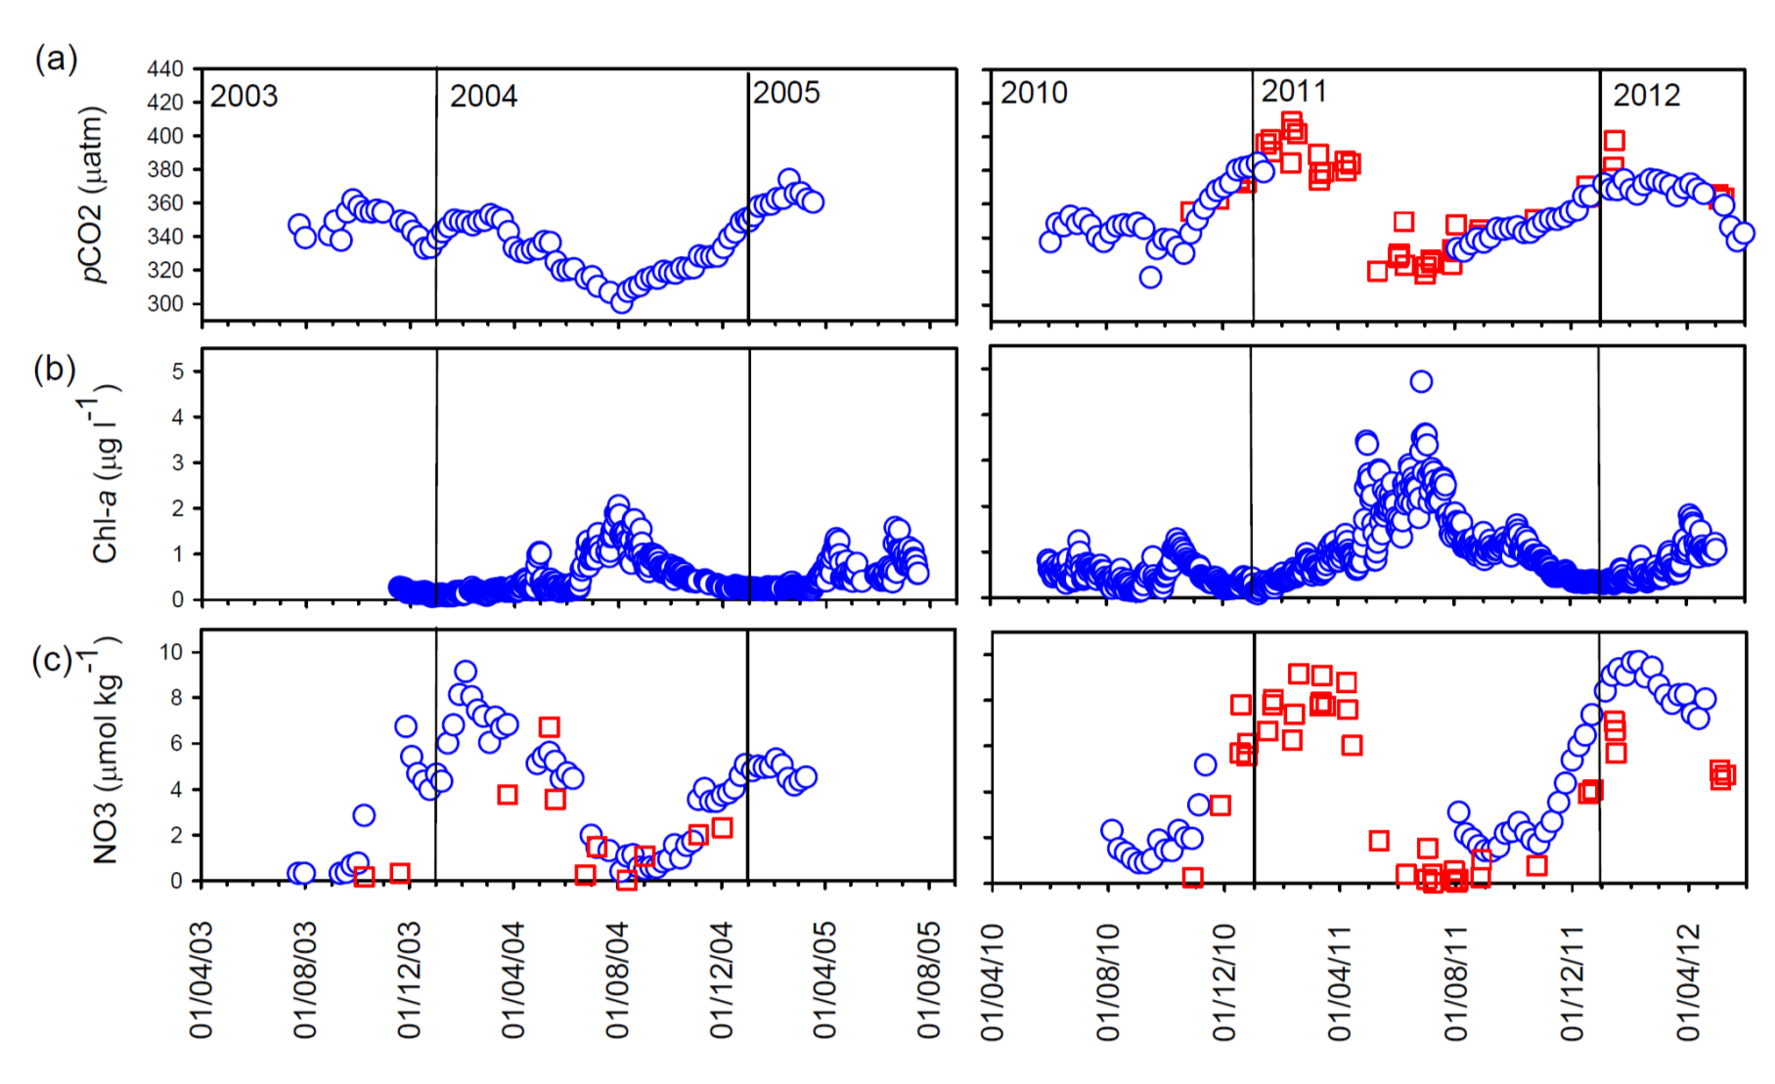
Carbon Dioxide & Chl-a
Blue: Observatory Red: Ships Of Opportunity (SOO)
(a) p(CO2); (b) chlorophyll a (c) weekly-averaged nitrate concentration.
Hartman et al. 2015

Slide 30
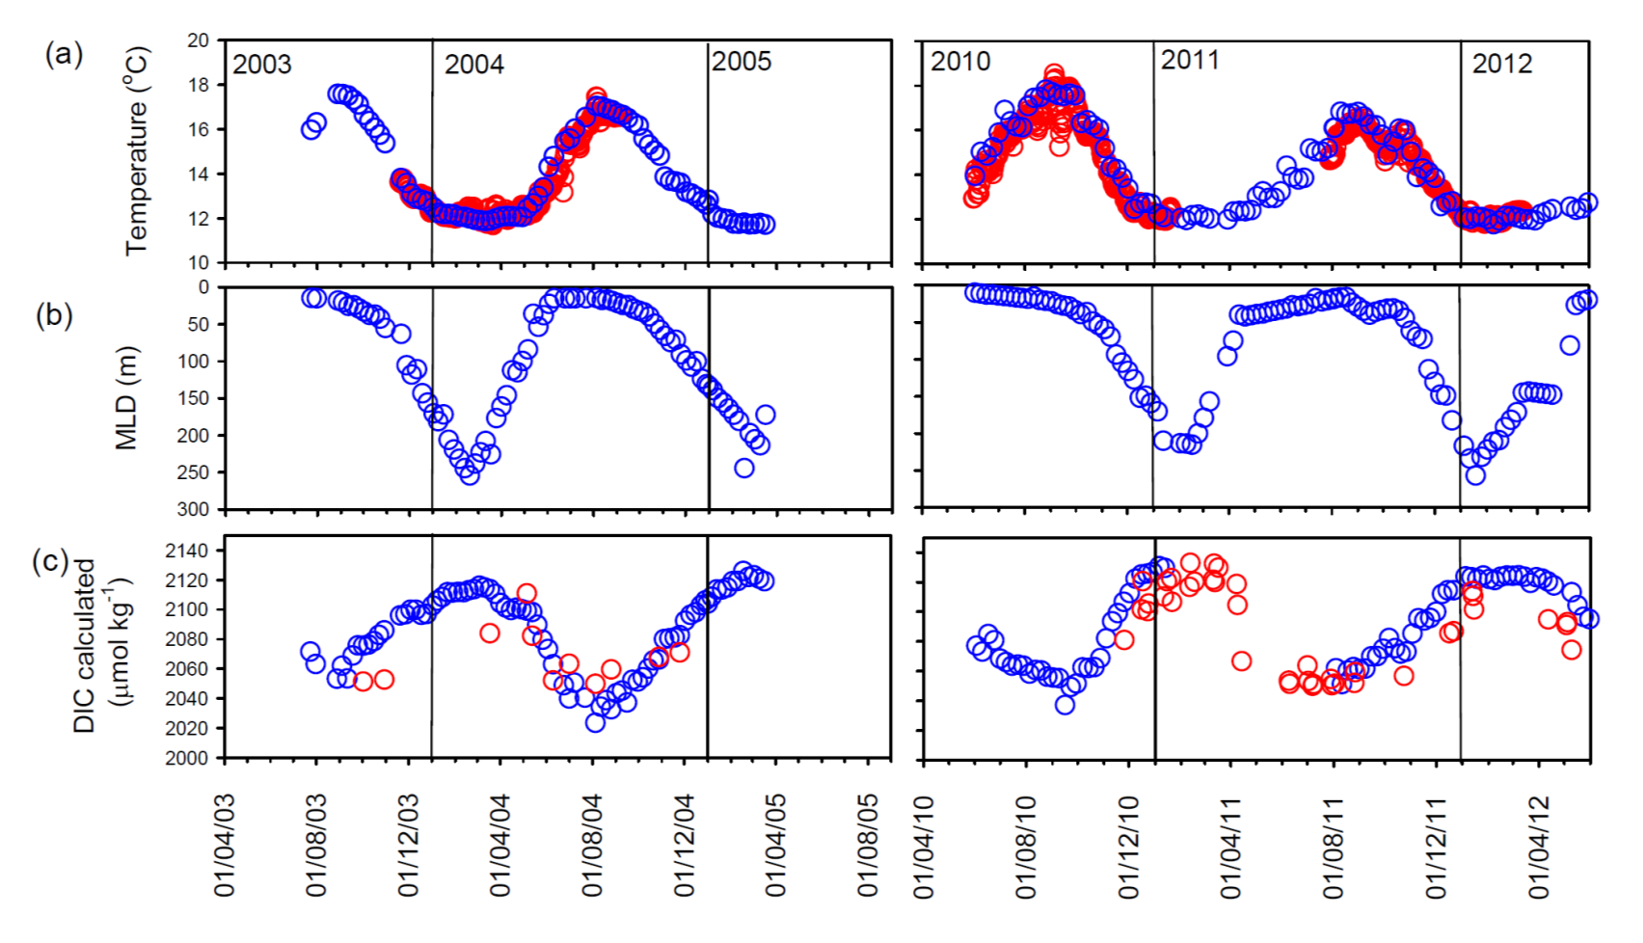
Temperature & DIC
Temperature at 30m depth;
Calculated mixed layer depth (MLD);
Calculated weekly dissolved inorganic carbon (DIC) (SOO data (red circles).
Hartman et al. 2015

Slide 31
CO₂ Flux calculations
1m depth temp. and CO₂ , 2m altitude wind speed and Mace Head atmospheric CO₂
A net CO₂ sink:
< -5.0 ± 2 mmol m⁻² d⁻¹
Hartman et al. 2015
Notes:
Monthly mean. Decrease in CO2 (RED) following bloom and as temperature increases. Inverse T & CO2 relationship. Flux calculated using in situ CO2 & temperature - in situ wind speed & atmospheric CO2 from Mace Head. Nightingale k

Slide 32
Example 3
Efficiency of the biological carbon pump

Slide 33
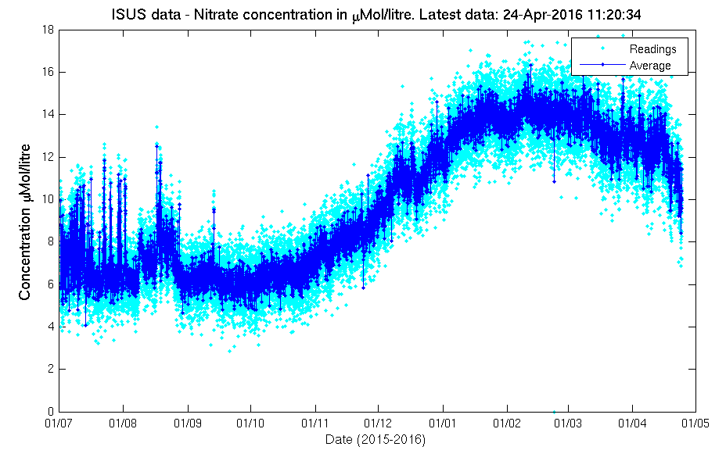

Slide 34
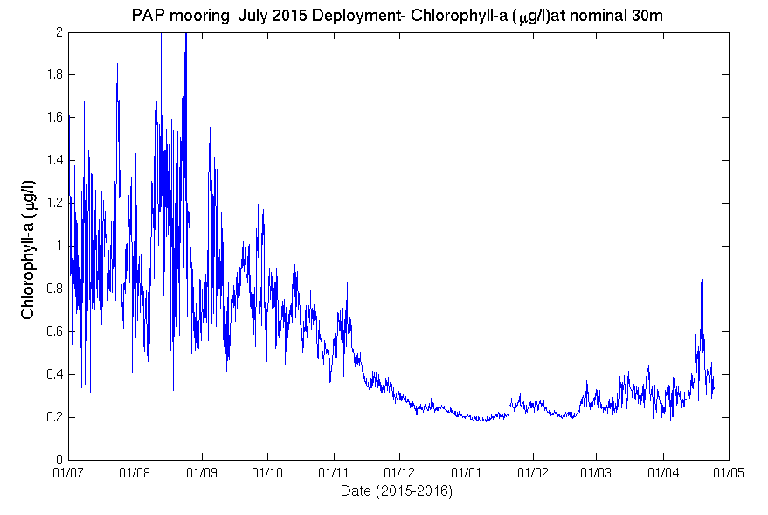

Slide 35
Perennial sink of CO₂
Strong interannual variability in hydrography, biogeochem and particle flux
Seasonal cycles of carbon and nitrogen show a winter maximum and summer minimum characteristic of highly productive sub-polar regions
The air–sea CO₂ flux was negative (i.e. oceanic uptake), with average of:
1.5 mmol m⁻² day⁻¹
Frigstad et al 2015

Slide 36
MLD integrated nitrate and NCP
NCP : 4.57 ± 0.85 mol C m⁻²
.
The C : N ratio of settling material was high (12) (CF Redfield 6.6),
Carbon overconsumption in North Atlantic
Frigstad et al 2015
Notes:
Method: The average monthly drawdowns of inorganic carbon and nitrogen were used to quantify the net community production (NCP) and new production.

Slide 37
Effiency of biological pump
Export efficiency: 15 %
Transfer efficiency was 4%
We hypothesize that the export regime at the PAP observatory will change with transition into more sub-tropical conditions over the next century
Frigstad et al 2015

Slide 40
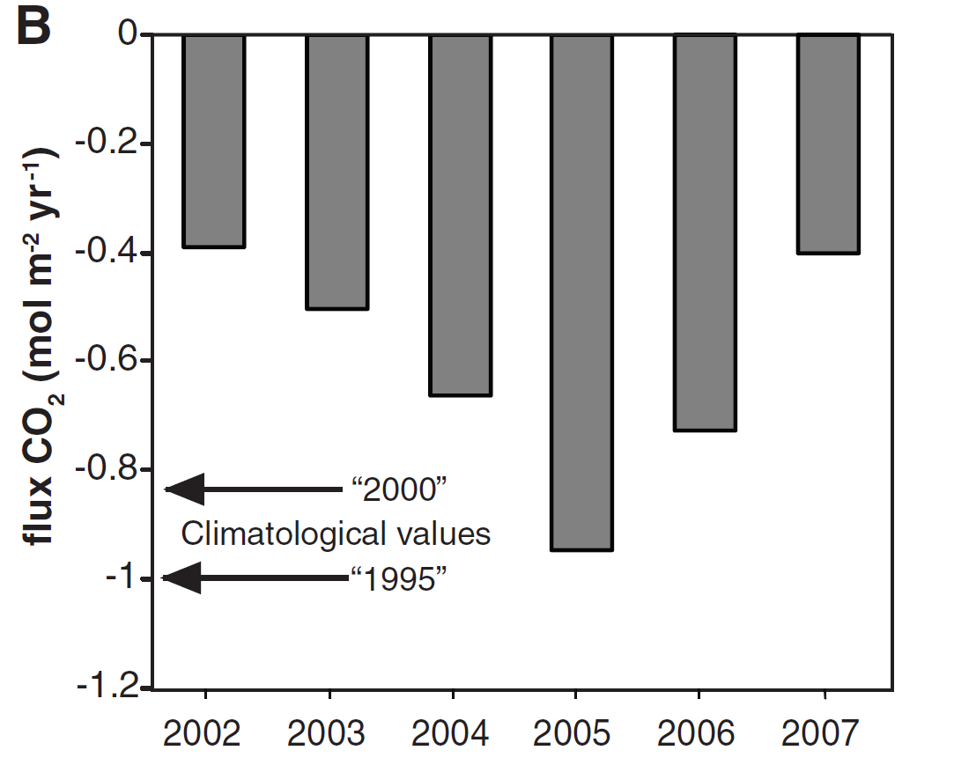
Significant year to year variability in the NE Atlantic CO₂ sink Watson et al., 2009
Is this related to changes in productivity or to large scale circulation changes?
Notes:
We found that the uptake of CO2 from the atmosphere changes over time. The x-axis are years from 2002 to 2007 and the y-axis is the Atlantic’s uptake, with the bars extending downwards meaning the uptake.
AND THIS IS EXACTLY WHY WE NEED TO MONITOR CARBON IN THE OCEANS TO UNDERSTAND HOW THIS DEVELOPS IN THE FUTURE, AND TO STUDY WHAT IS CAUSING THIS.

Slide 41
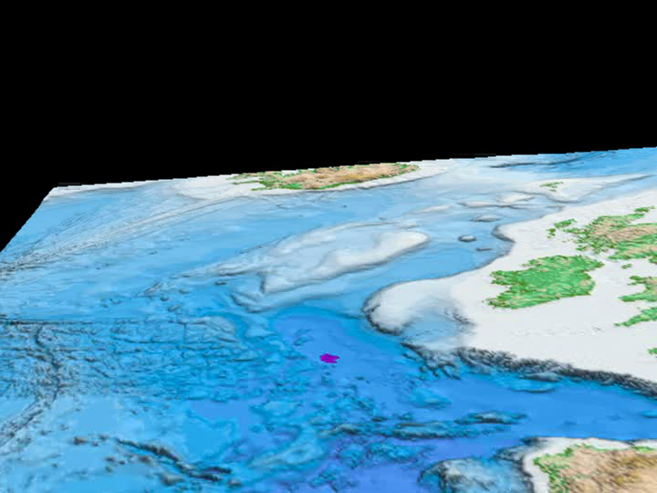
The Porcupine Abyssal Plain observatory (PAP)

Slide 42
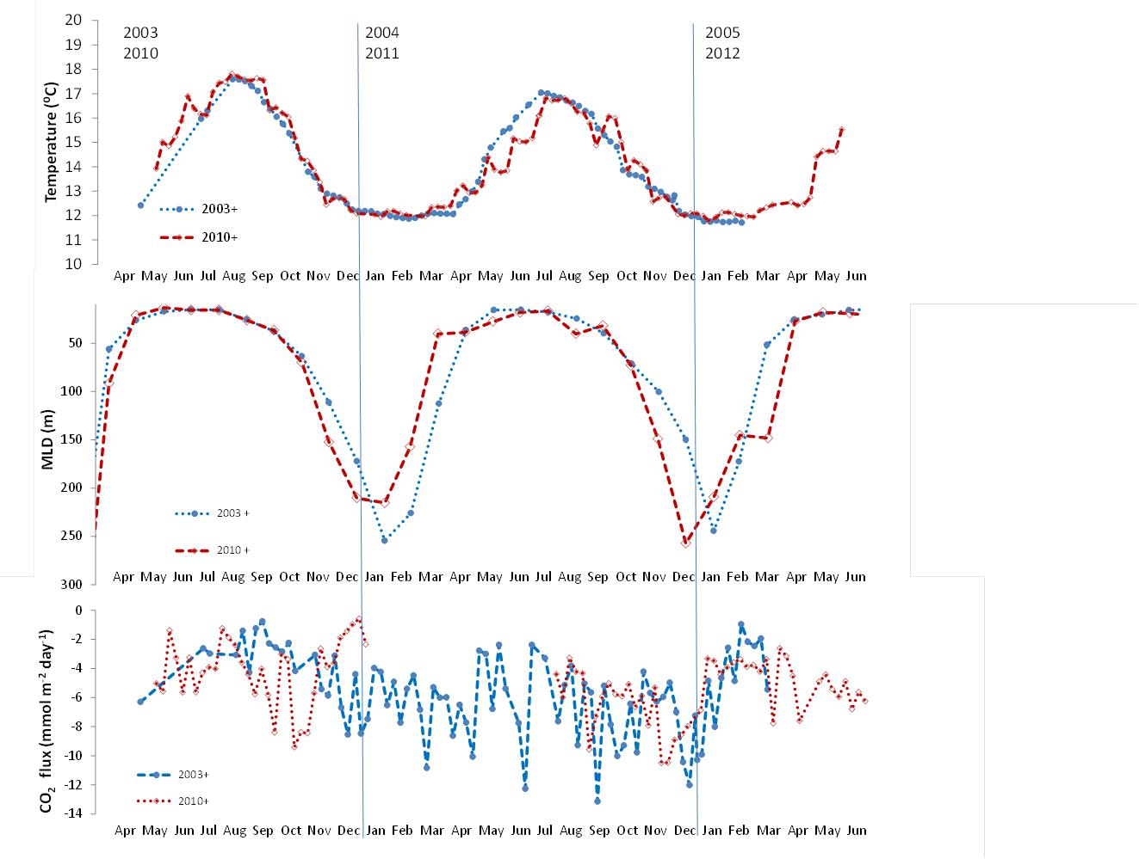
Argo
Hartman et al. 2015

Slide 43
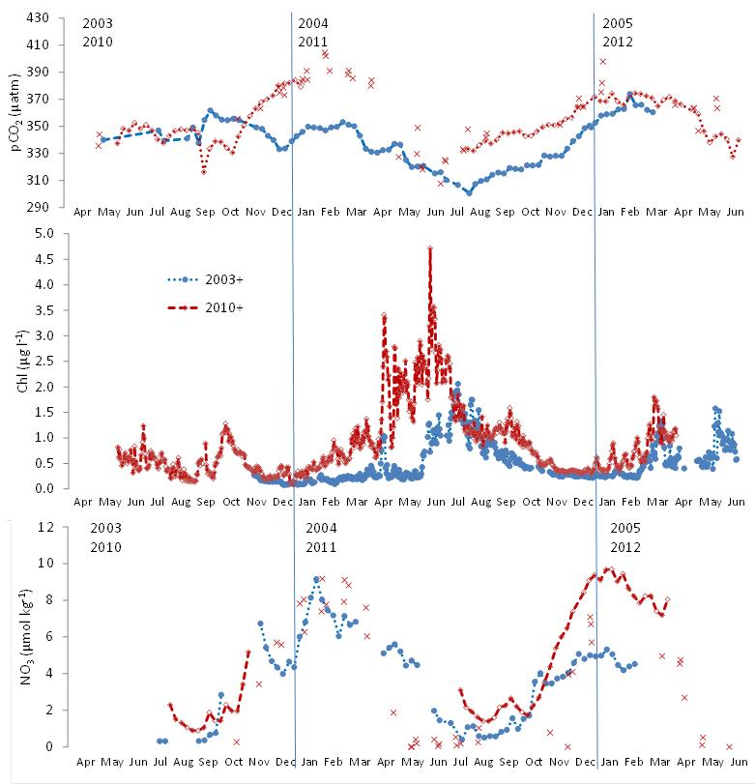
Hartman et al. 2015

Slide 45
Example 4

Slide 46
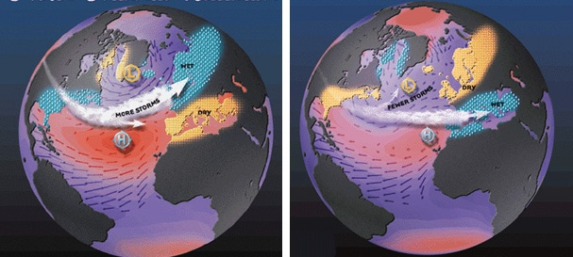
North Atlantic Oscillation
Positive Phase Negative Phase

Slide 47
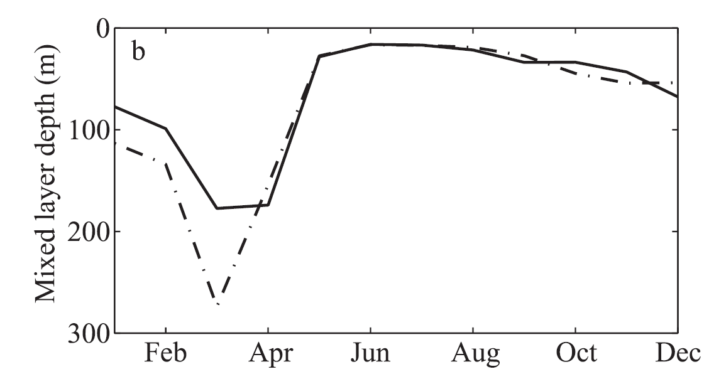
Mixed-layer depth in negative NAO years (solid) and positive NAO years (dashed)
Henson et al 2012

Slide 48
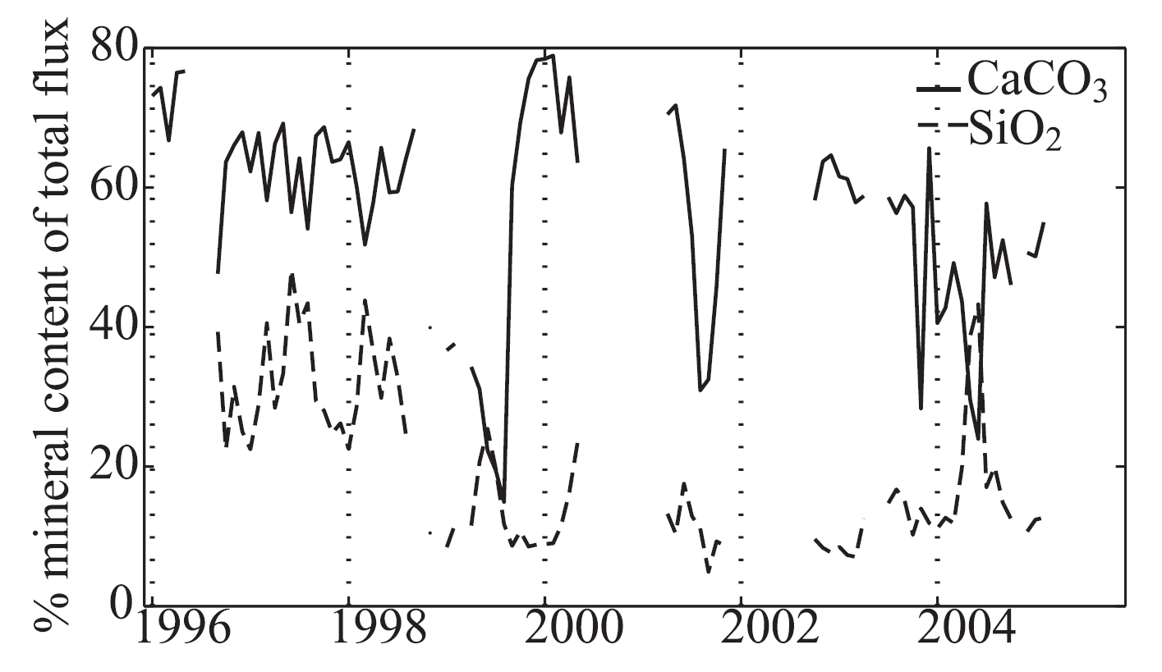
Henson et al 2012

Slide 49
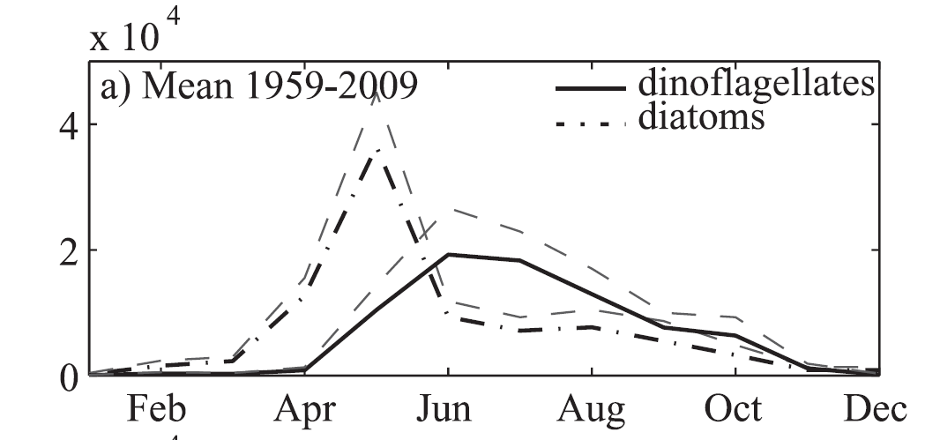

Phytoplankton abundance in extended PAP region (1959-2009)
Henson et al 2012

Slide 50
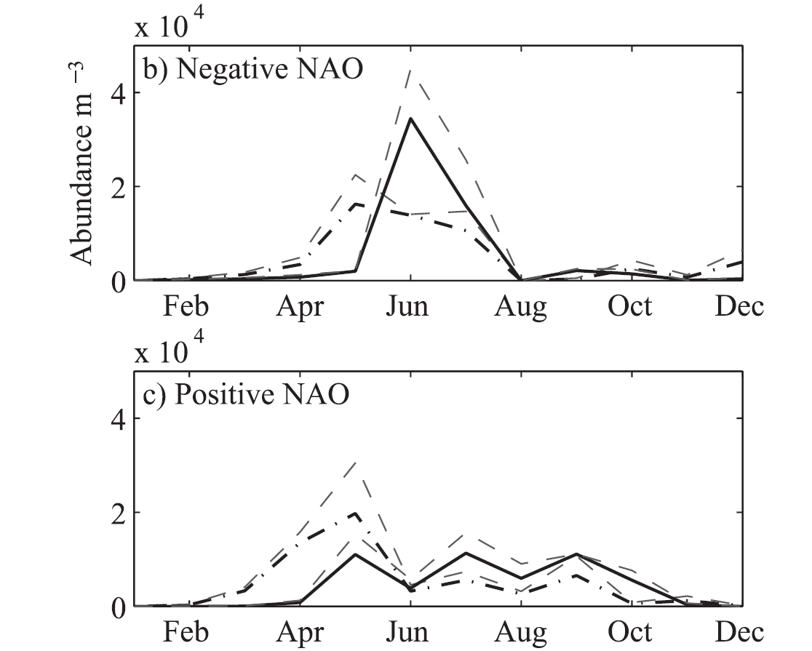

Phytoplankton abundance in negative and positive NAO years
Henson et al 2012

